Slide 1
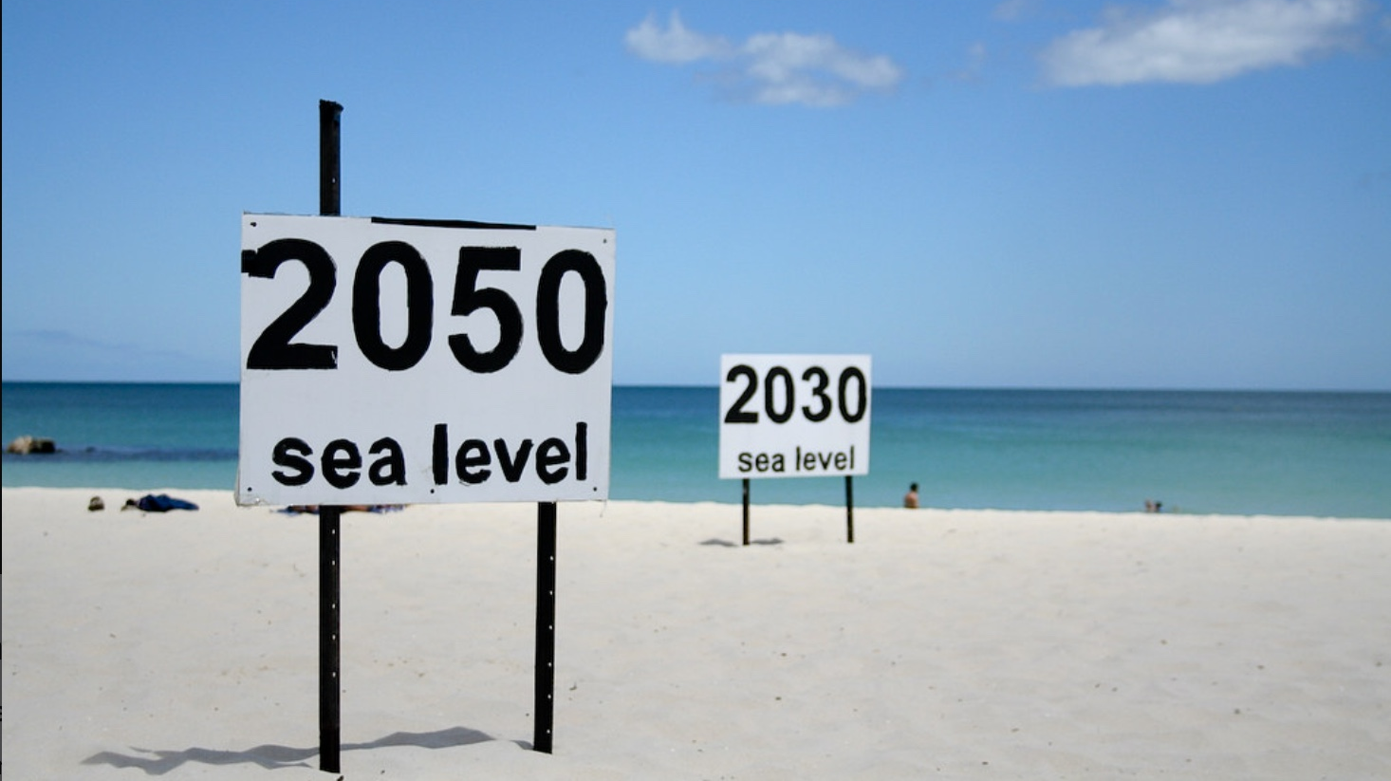
Artists & Sea Level Rise
Ashley Rue
(go_greener_oz, Rising sea levels 2008)

Slide 2
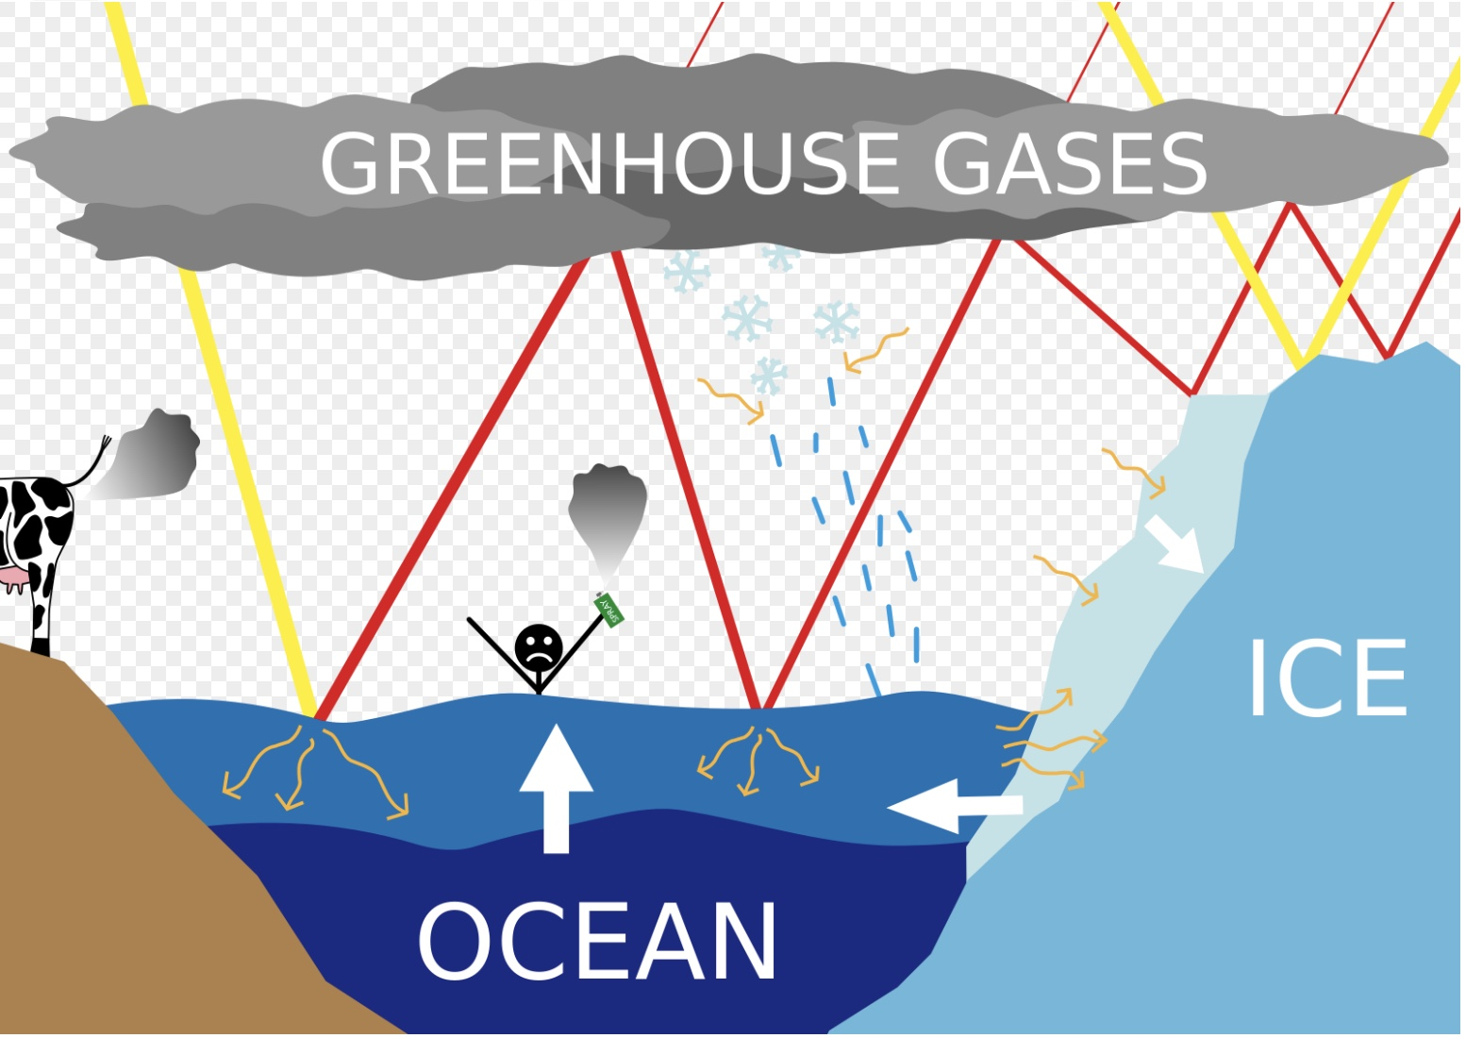
Sea Level Rise
“Sea level rise is an increase in the level of the world’s oceans due to the effects of global warming (National Geographic Society, 2023).”
Created by excessive greenhouse gas emissions and melted water from glaciers and ice sheets (National Geographic Society, 2023)
Sea level causes catastrophic consequences for coastal habitants (National Geographic Society, 2023)
Nature suffers from lack of basic needs
Coastal ecosystems struggle to adapt -> Stripped underwater species -> Loss of coastal food and jobs (Parkes, 2023)
(Höpfner, Sea-level-rise scheme)

Slide 3
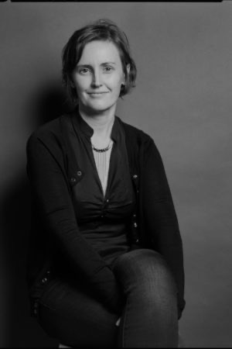
Sarah Cameron Sunde
Interdisciplinary environmental artist and director
Performance, video, and socially-engaged public art
Awarded a Guggenheim Fellowship
Series of 9 performances and video artworks made on 6 continents
Engages public in questions around deep time and our place in environment
Creates interactive situations
(Sunde, SARAH CAMERON SUNDE- About)
(Green, Sarah Cameron Sunde )

Slide 4
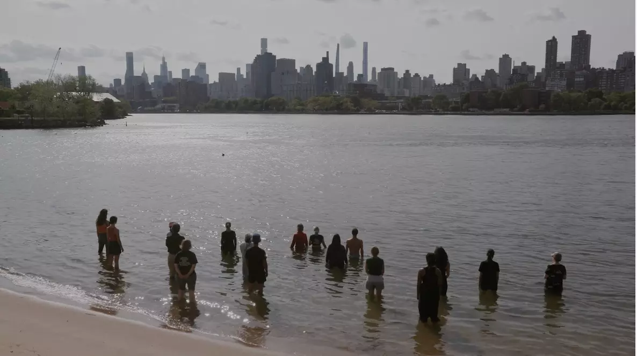
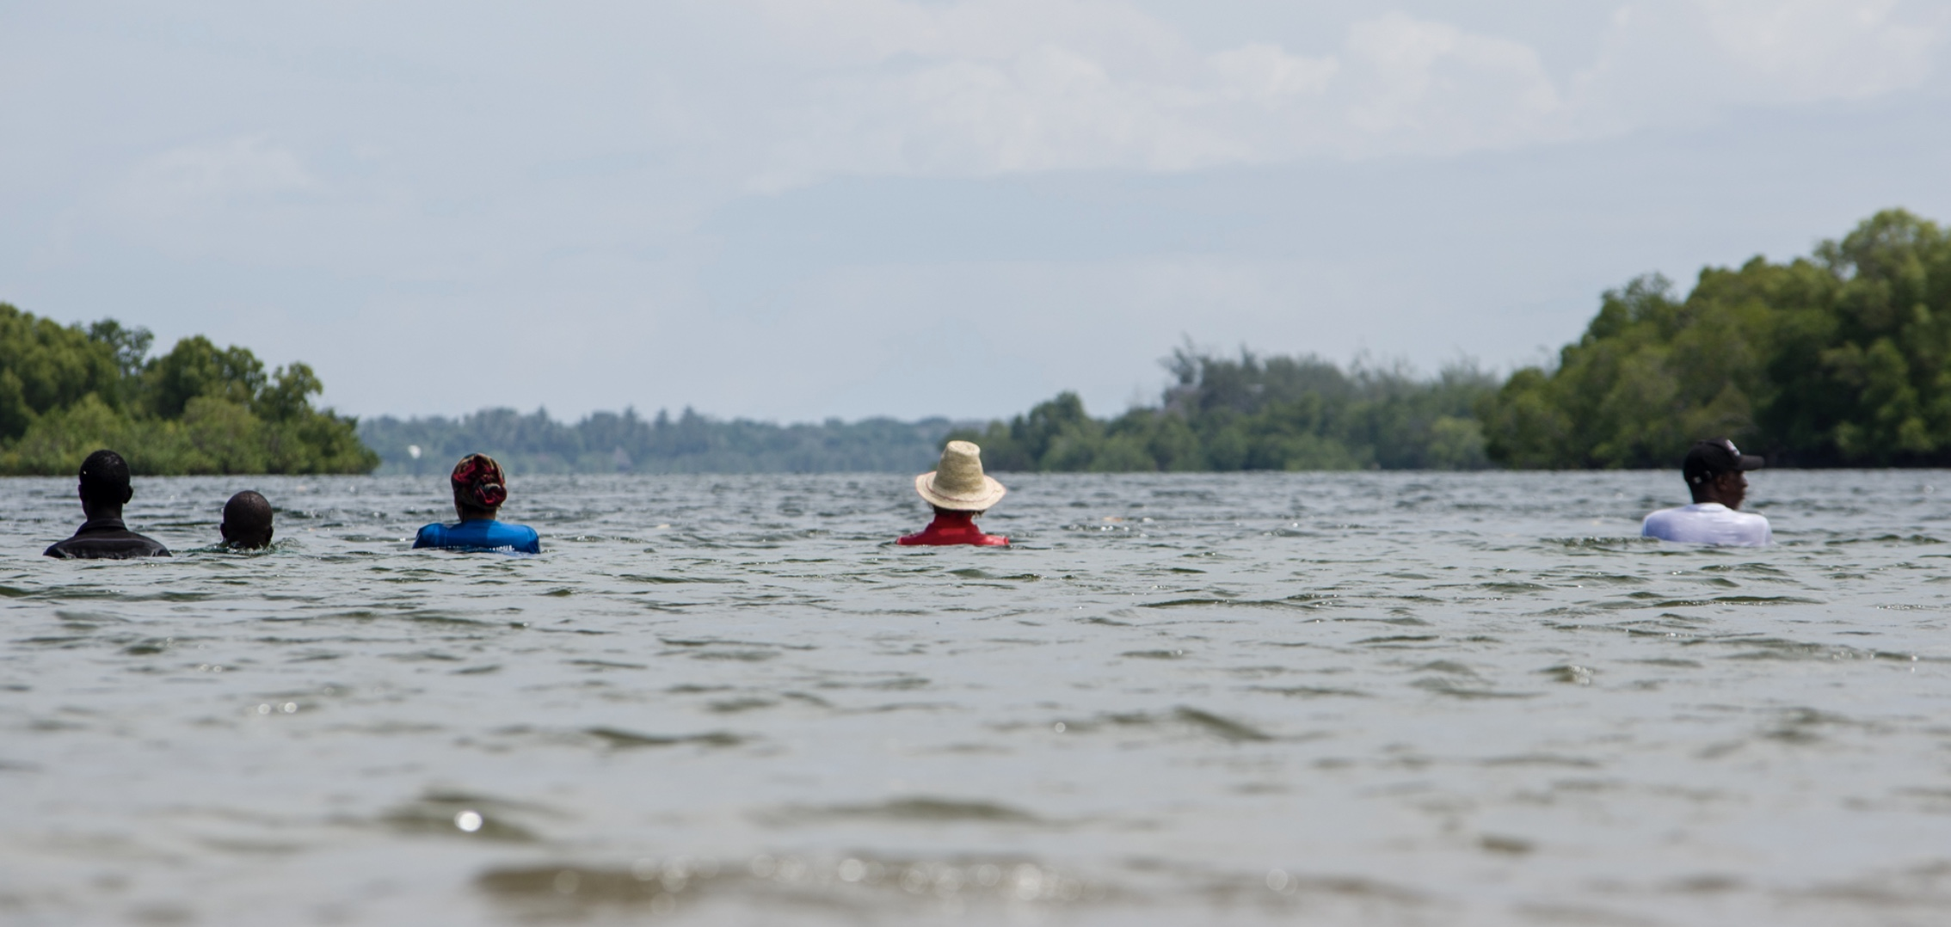
36.5 / A Durational Performance with the Sea (2013-2022)
(Sunde, 36.5: A Durational Performance with the Sea)
(Sunde, 36.5: A Durational Performance with the Sea)
Inspired to create series after Hurricane Sandy hit NYC in 2012 (Parkes, 2023)
Performed (in order): Maine, Mexico, California, The Netherlands, Bangladesh, Brazil, Kenya, New Zealand, and New York
Stands for an entire tide cycle in seawater for water rise and fall against the body – about 13 hours (Parkes, 2023)

Slide 5
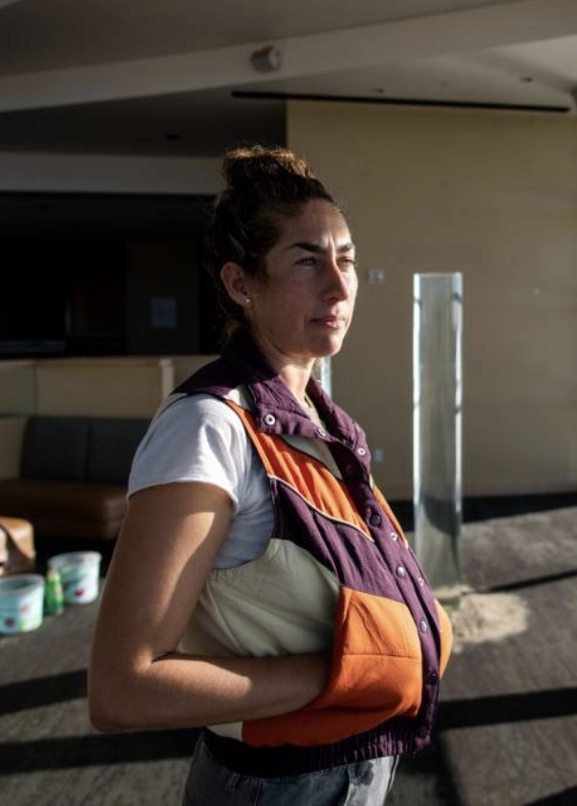
Ana Teresa Fernandez
Started career from growing up in Tampico, Mexico
Stench in air from oil refineries on beach trips
Resides in San Francisco
Performance, video, photography, painting, and sculpture (Fernández, Bio)
Subjects: Land, history, gender, climate, and culture
Enacted narratives bring what binds and divides us as humans to surface (Fernández, Bio)
(LaBerge, 2022)

Slide 6
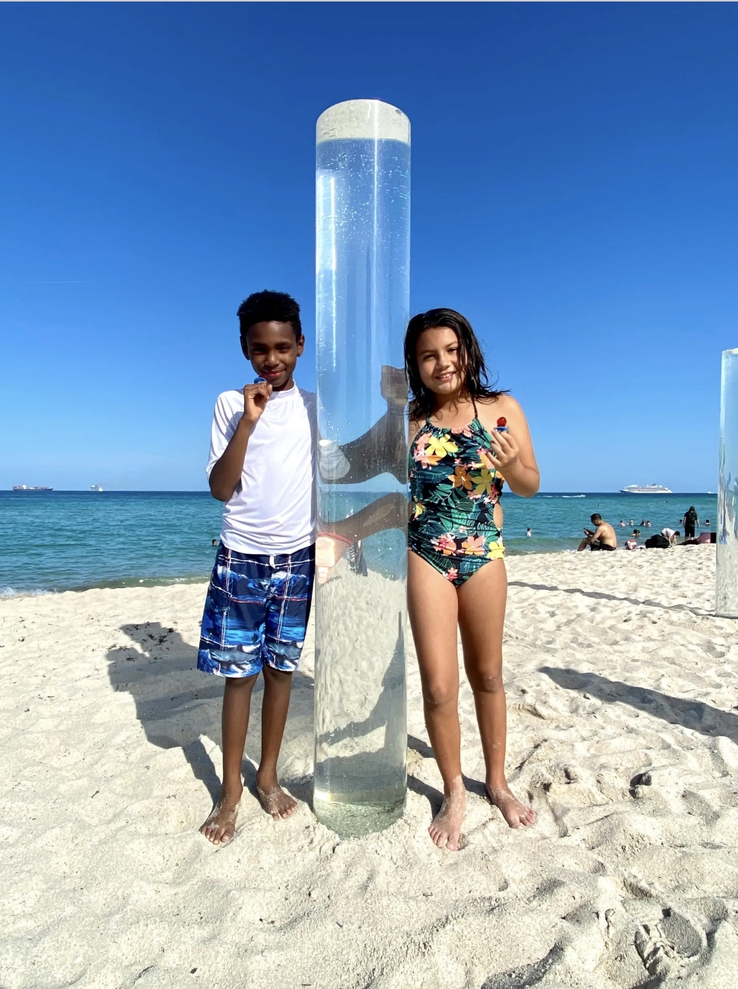
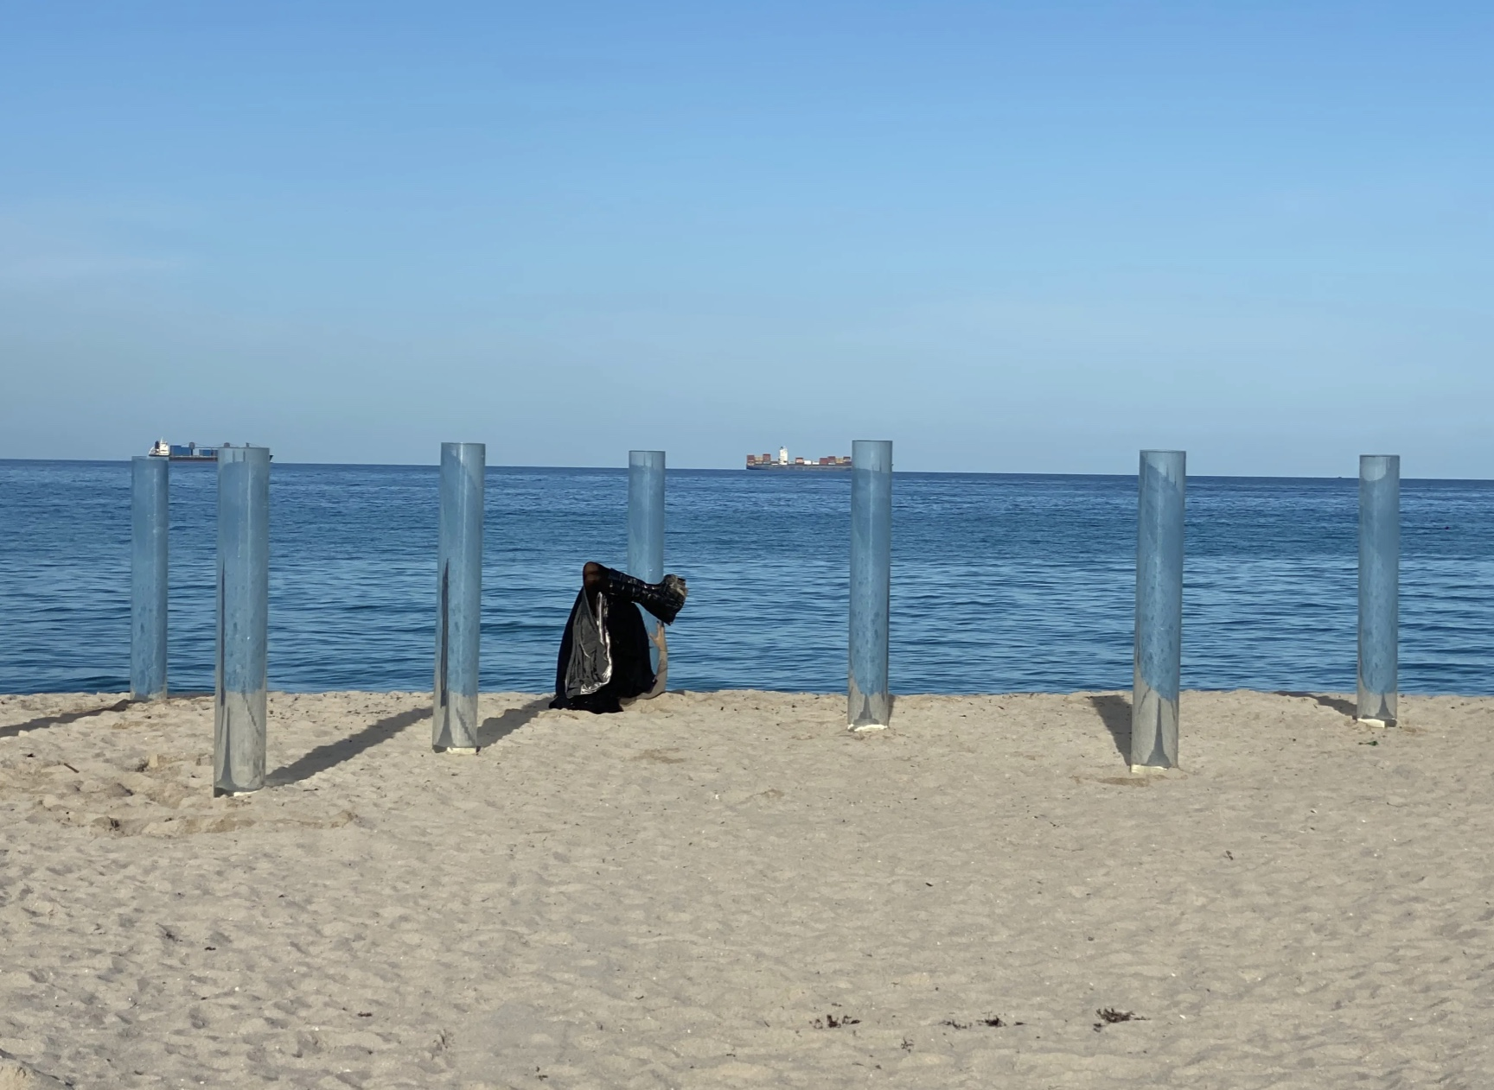
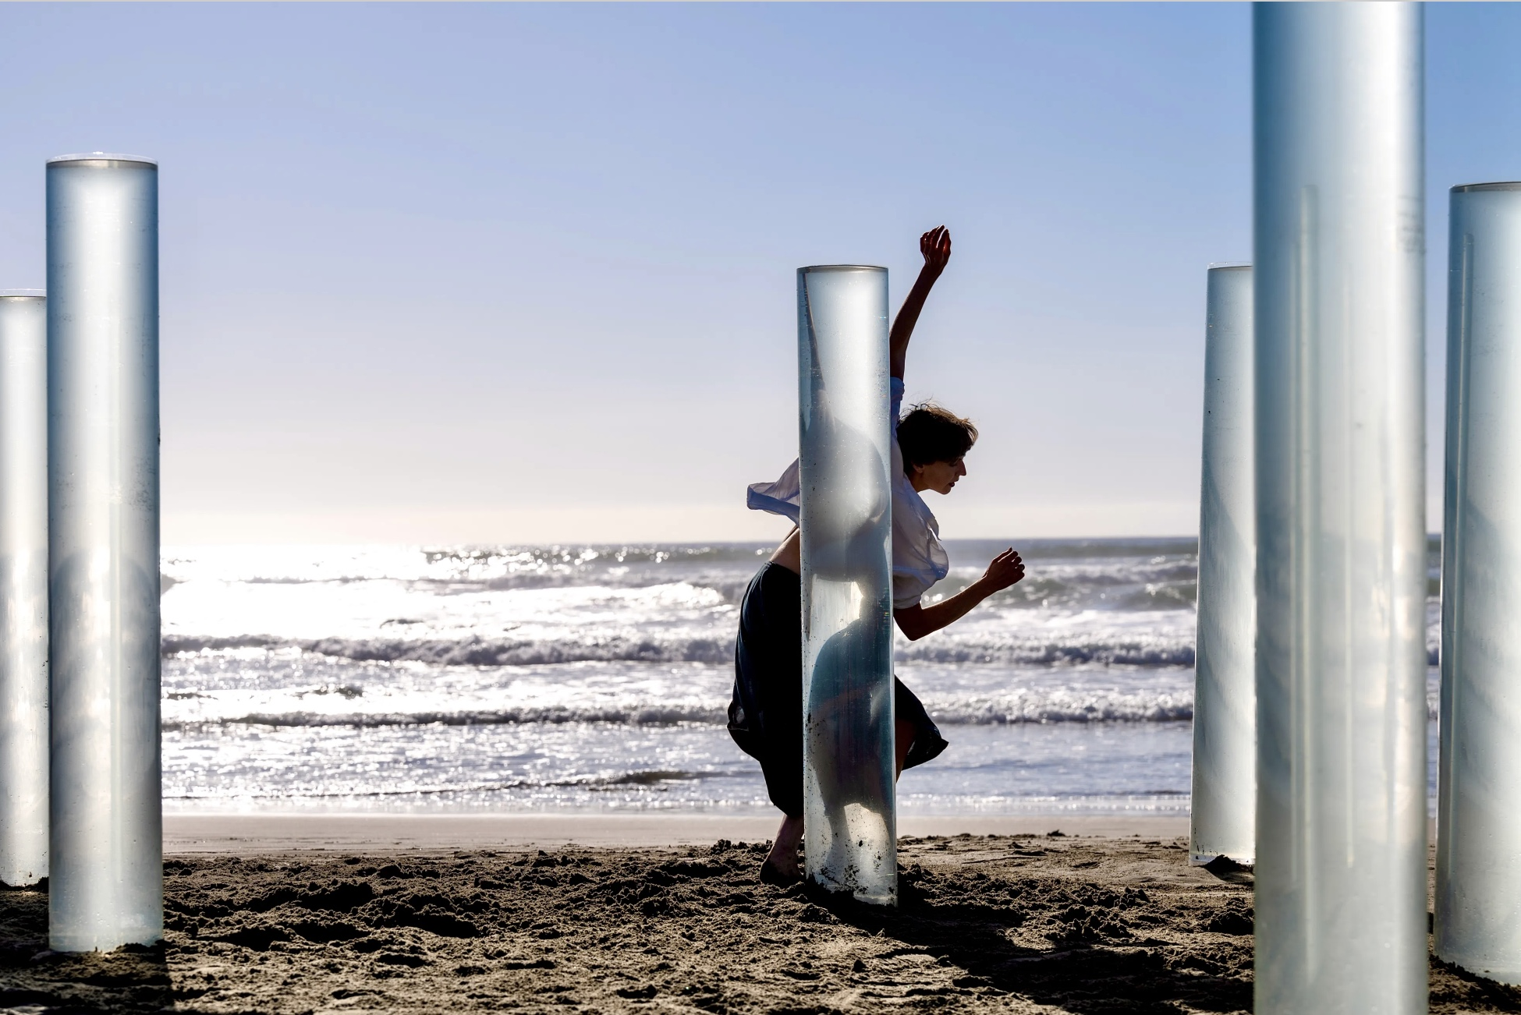
On the Horizon
(Fernández, 2022)
(Fernández, 2022)
“Sea bodies: Extension of the body of water.” – Ana Teresa Fernandez
Beaches in California and Mexico (Klivans, 2022)
16 acrylic resin cylinders filled with seawater from Pacific Ocean (Klivans, 2022)
10 inches wide and 6 feet tall
At the shore-line where water ends and lands begins
Community joins by filling bucks of water to fill tubes (Klivans, 2022)
(Fernández, 2023)

Slide 7
Timo Aho
Pekka Niittyvirta
(Vallasjoki, Timo Aho)
(Farraige, Pekka Niittyvirta)

Slide 8
Finnish Artists
Timo Aho
Pekka Niittyvirta
Born – 1980, Finland
MFA - Visual Arts: Art University’s Academy of Fine Arts Helsinki (Aho, Bio)
BA - Glasgow School of Art’s Sculpture and Environmental Art Department (Aho, Bio)
Wide range of materials and media: light, air, and sound (Aho, Bio)
Born – 1974, Helsinki
MA – Photography: TAIK (Aalto University), Helsinki, Finland (Niittyvirta, CV & Bio)
BA – Photography: Kent Institute of Art and Design, Rochester, UK (Niittyvirta, CV & Bio)
Installation, photography, video, and alternative image technologies (Niittyvirta, CV & Bio)
(Raymond, 2021)

Slide 9
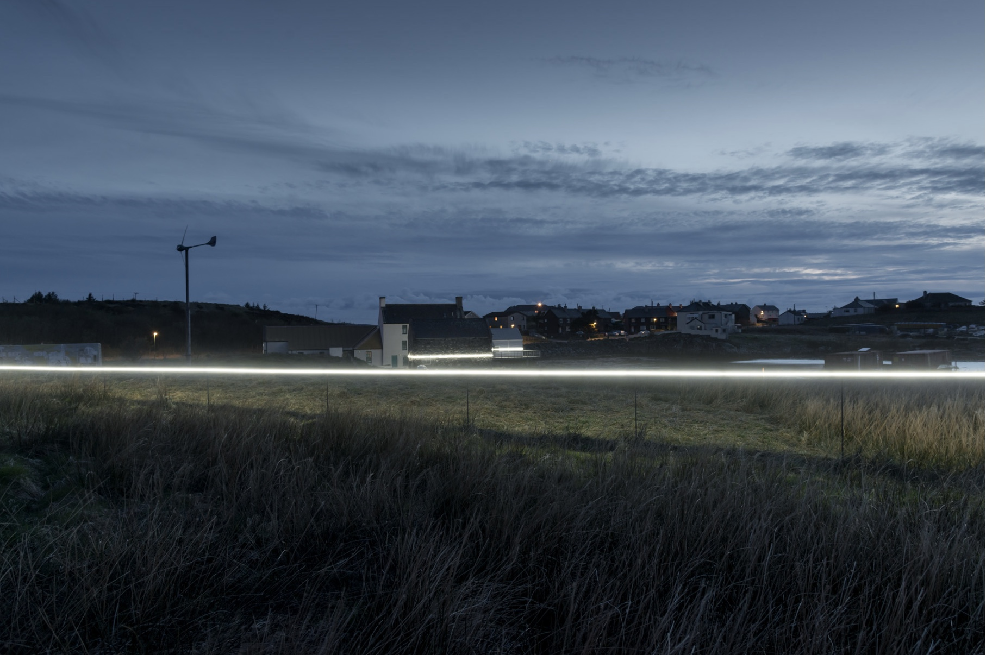
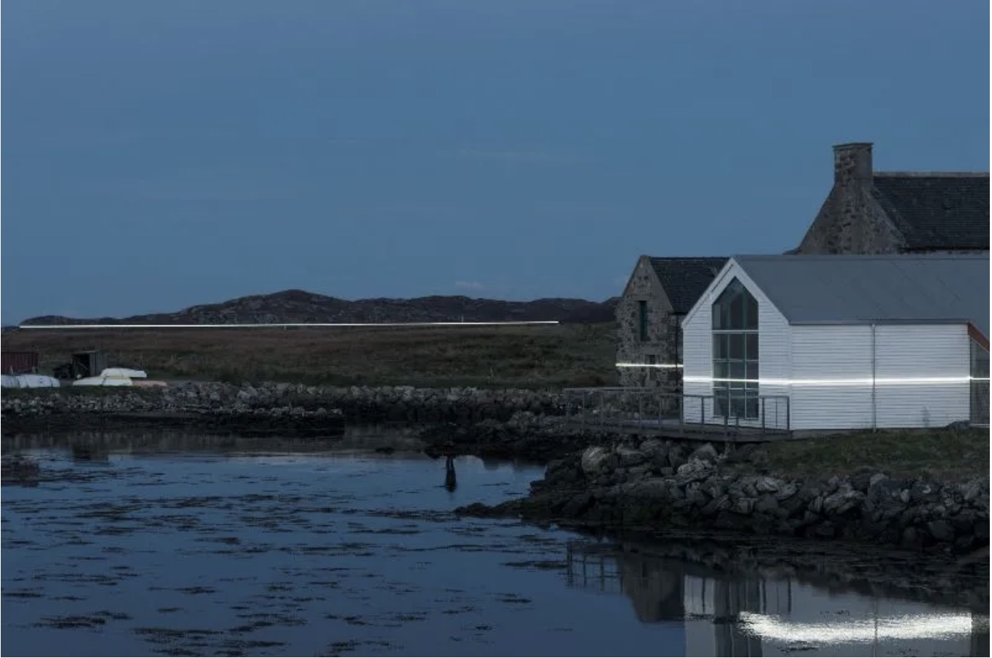
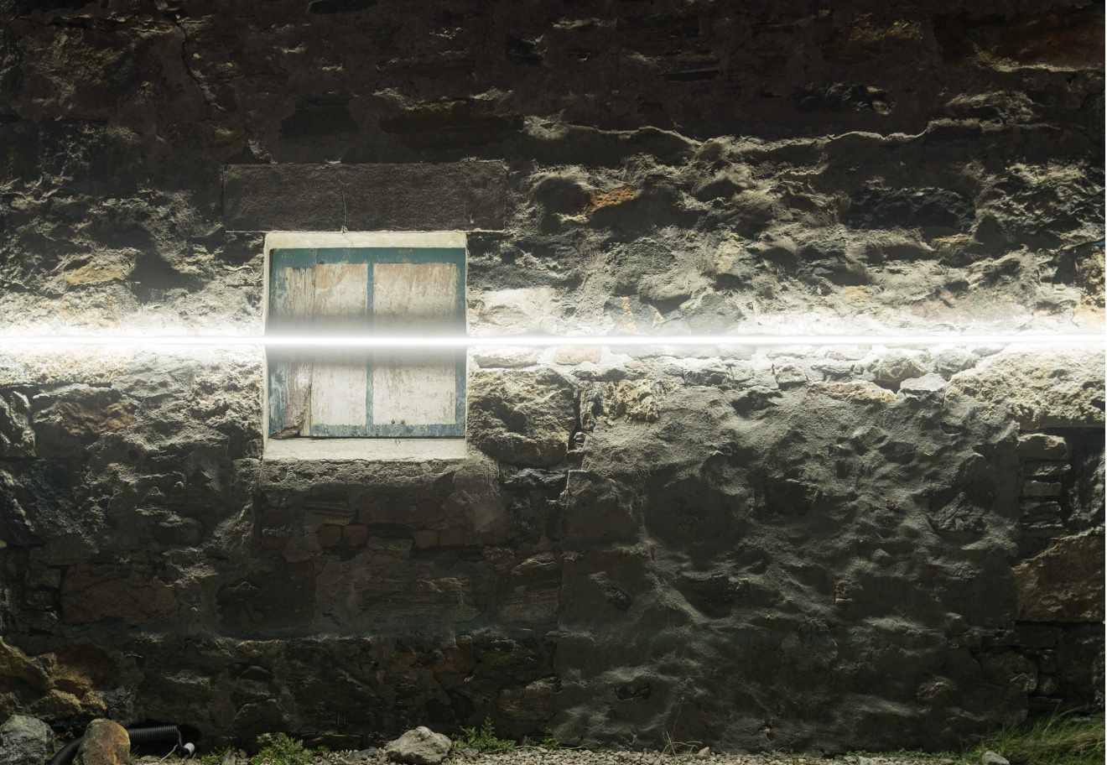
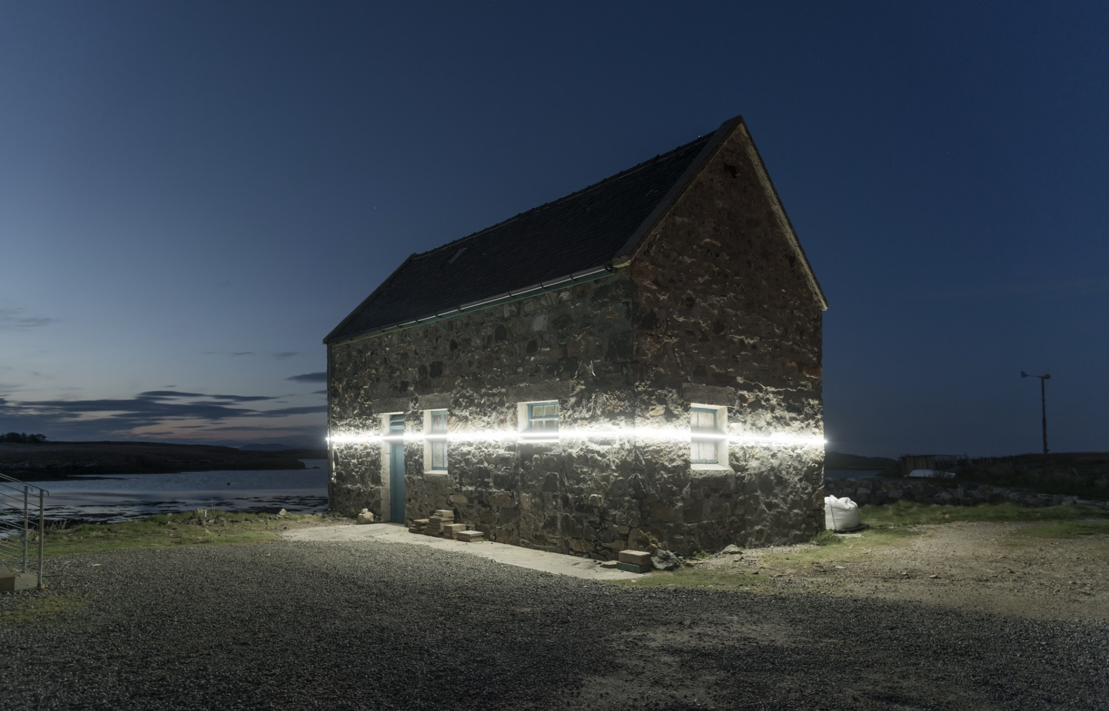
Lines (57° 59′ N, 7° 16’W)
Lochmaddy, UK
3 LED lights triggered by high tide sensor (Niittyvirta, Lines (57° 59′ N, 7° 16'W))
Impact of climate change and relationship with long-term effects (Megson, 2022)
(Nittyvirta, Lines (57° 59′ N, 7° 16'W))
(Niittyvirta, Lines (57° 59′ N, 7° 16'W))
(Niittyvirta, Lines (57° 59′ N, 7° 16'W))
(Niittyvirta, Lines (57° 59′ N, 7° 16'W))

Slide 10
References
Aho, T. (n.d.). Bio. Timo Aho. https://www.timoaho.com/about/
Farraige, L. na. (2021). Pekka Niittyvirta. photograph.
Fernández, A. T. (2023, November 10). On the Horizon. Ana Teresa Fernández. https://anateresafernandez.com/on-the-horizon/
Fernández, A. T. (n.d.). Bio. Ana Teresa Fernández. https://anateresafernandez.com/bio/
go_greener_oz. (2008). Rising sea levels. photograph, Cottesloe Beach, Australia.
Green, G. (n.d.). Sarah Cameron Sunde. photograph.
Höpfner, E. (2009). Sea-level-rise scheme. photograph.
Klivans, L. (2022, March 11). To Understand Sea Level Rise, This Climate Artist Wants You to Feel It in Your Body. KQED. https://www.kqed.org/science/1978628/to-understand-sea-level-rise-this-climate-artist-wants-you-to-feel-it-in-your-body
LaBerge, B. (2022). Ana Teresa Fernández. photograph.
Megson, K. (2022, November 4). Six Artists Making Sea Level Rise Visible. Metropolis. https://metropolismag.com/projects/six-art-installations-making-sea-level-rise-visible/

Slide 11
References contd.
National Geographic Society. (2023, October 19). Sea Level Rise. National Geographic. https://education.nationalgeographic.org/resource/sea-level-rise/
Niittyvirta, P. (n.d.). CV & Bio. Pekka Niittyvirta . https://niittyvirta.com/cv/
Niittyvirta, P. (n.d.). Lines (57° 59′ N, 7° 16’W). Pekka Niittyvirta. https://niittyvirta.com/lines-57-59-n-7-16w/
Parkes, G. (2023, January 12). Sea level is rising around the world: art is putting it in the spotlight. World Economic Forum. https://www.weforum.org/agenda/2023/01/art-putting-rising-sea-levels-in-the-spotlight-davos23/
Raymond, N. (2012). Finland Grunge Flag. photograph.
Sunde, S. C. (n.d.-a). 36.5: A Durational Performance with the Sea. https://www.36pt5.org/
Sunde, S. C. (n.d.-b). SARAH CAMERON SUNDE- About. Sarah Cameron Sunde. https://www.sarahcameronsunde.com/about/
Vallasjoki, T. (n.d.). Timo Aho. photograph.

