Slide 1
BLUE CONNECTIONS
SHIPPING + GLOBALIZATION IN ART

Slide 2
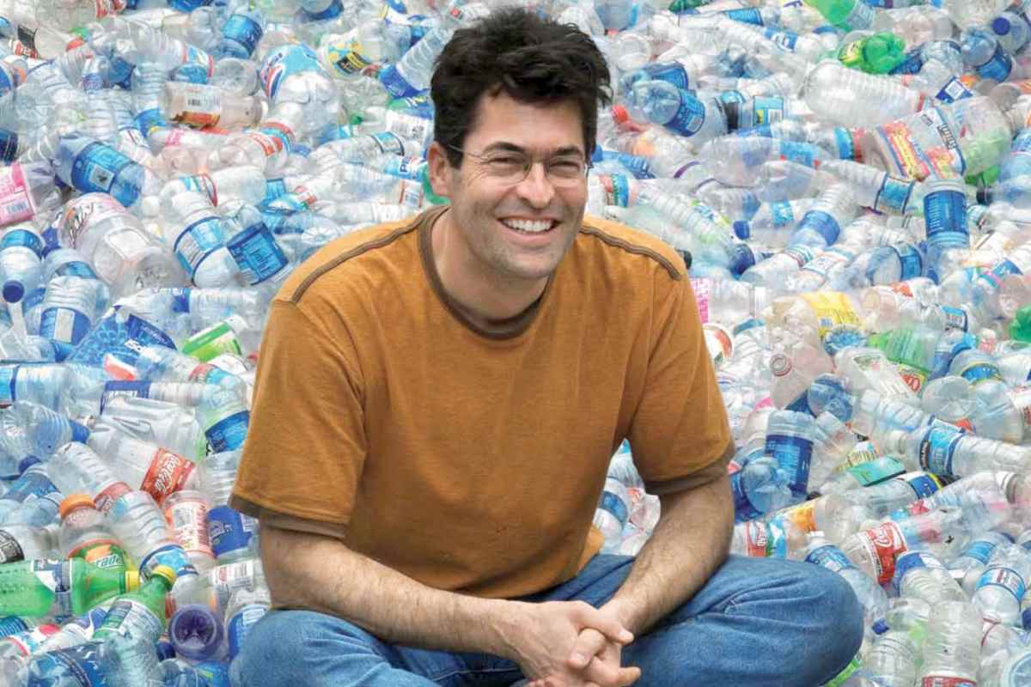
Chris Jordan

Slide 3
Chris Jordan
Running the Numbers: An American Self-Portrait, Shipping Containers, 2007
Depicts 38,000 shipping containers, the number of containers processed through American ports every twelve hours.

Slide 4
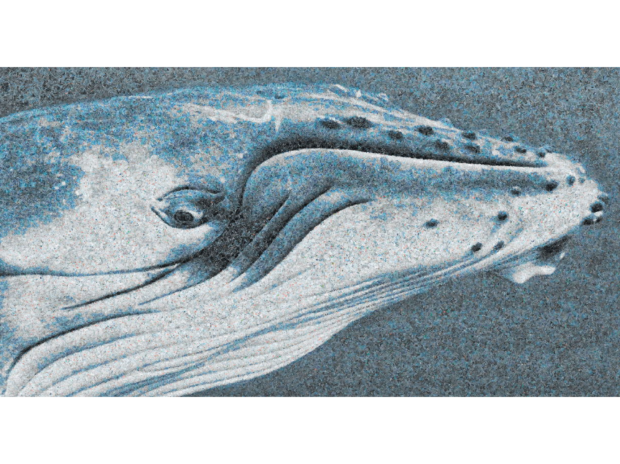
Chris Jordan
Running the Numbers II: Portraits of global mass culture, Whale, 2011
Depicts 50,000 plastic bags, equal to the estimated number of pieces of floating plastic in every square mile in the world's oceans

Slide 5
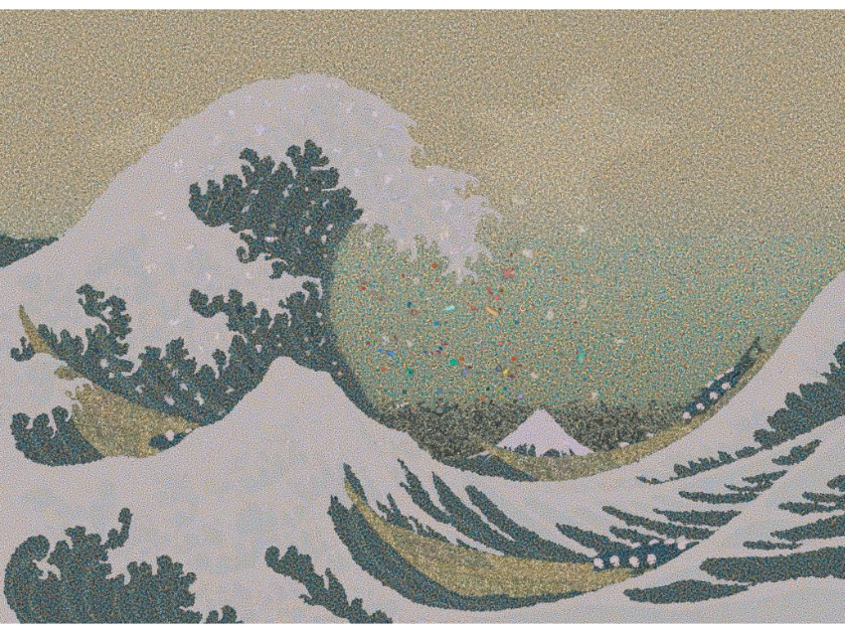
Chris Jordan
Running the Numbers II: Portraits of global mass culture, Gyre, 2009
Depicts 2.4 million pieces of plastic, equal to the estimated number of pounds of plastic pollution that enter the world's oceans every hour. All of the plastic in this image was collected from the Pacific Ocean.

Slide 6
Mea Duke
The Port is the Storm, 2017

Slide 7
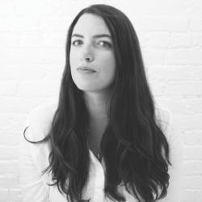
Mea Duke

Slide 8
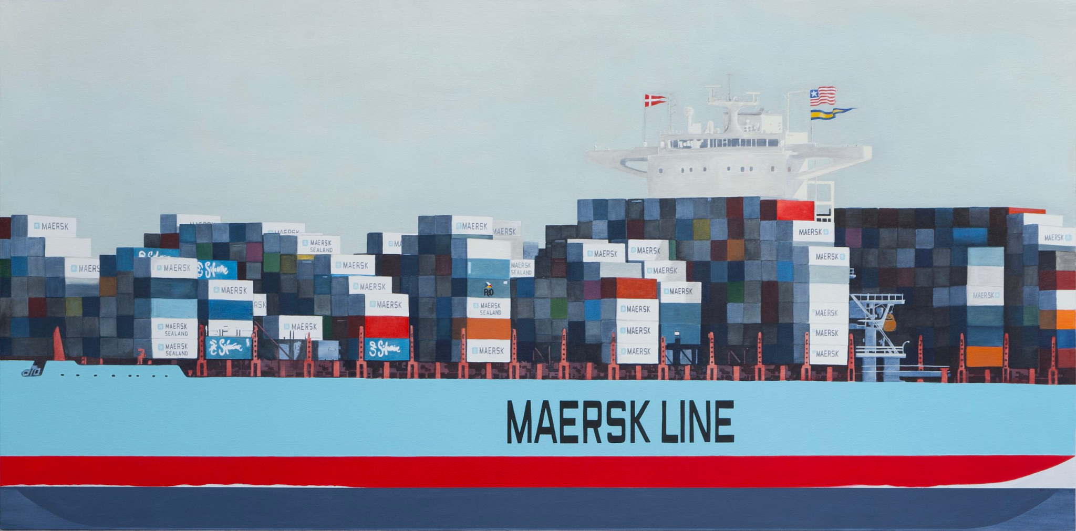

Slide 9
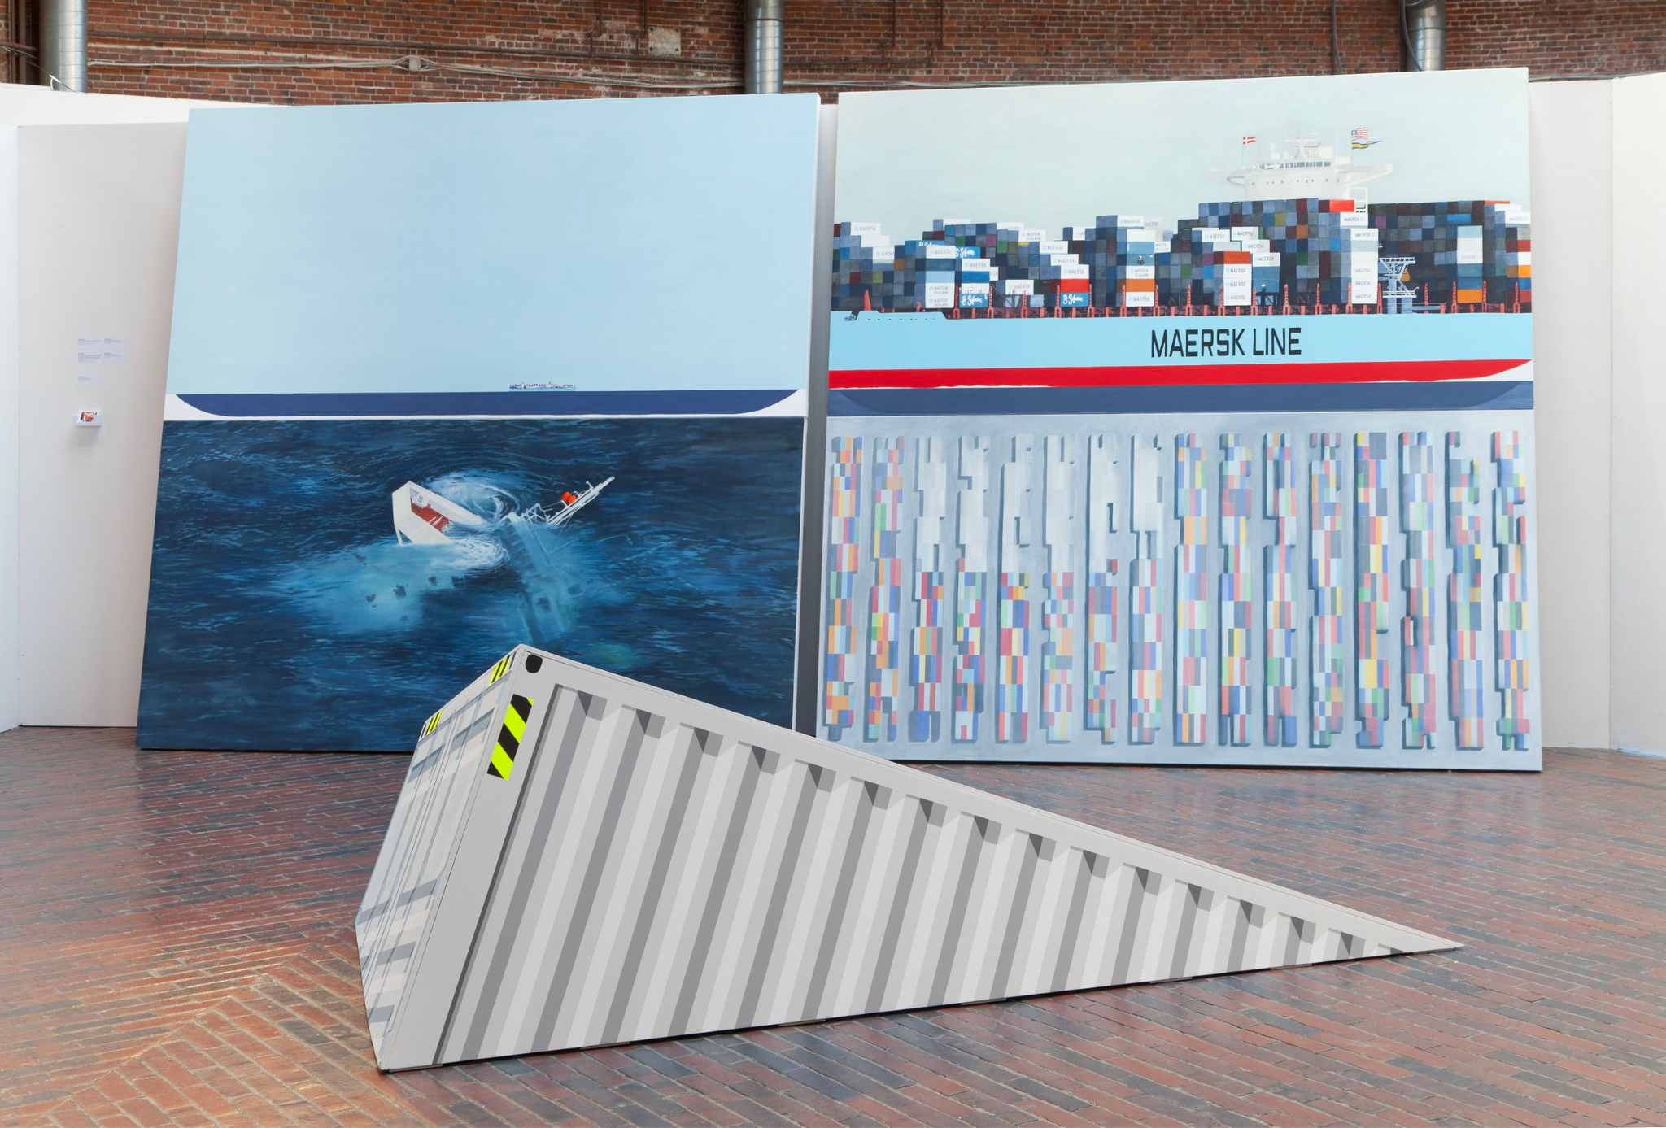

Slide 10
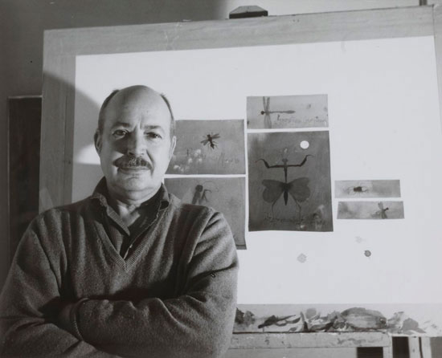
Claus Hoie

Slide 11
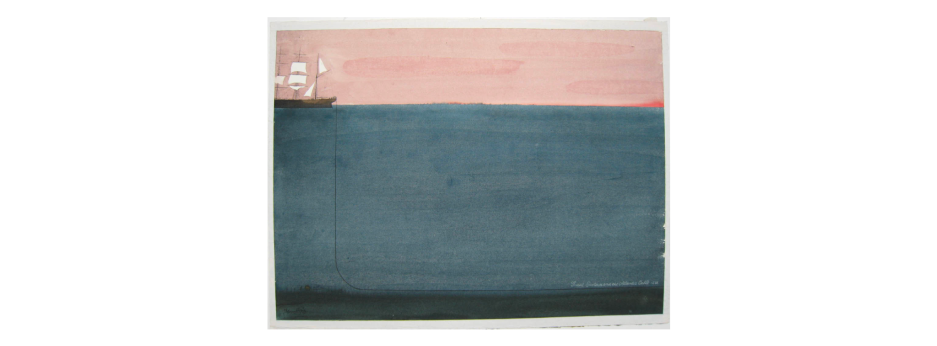
Claus Hoie
Great Eastern And The Atlantic Cable, 1970

Slide 12
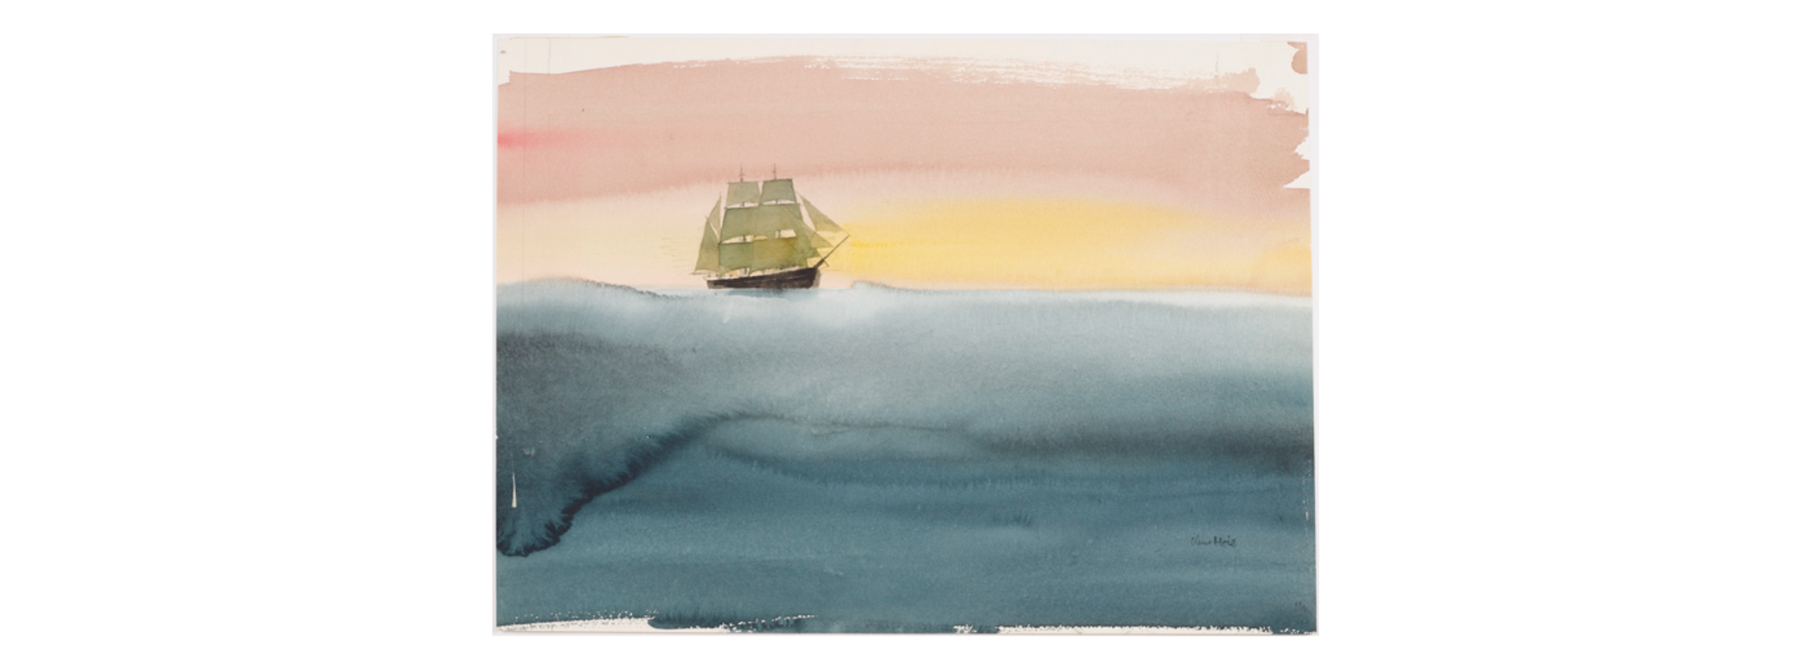
Claus Hoie
Ship in Calm Sea, 1970

Slide 13
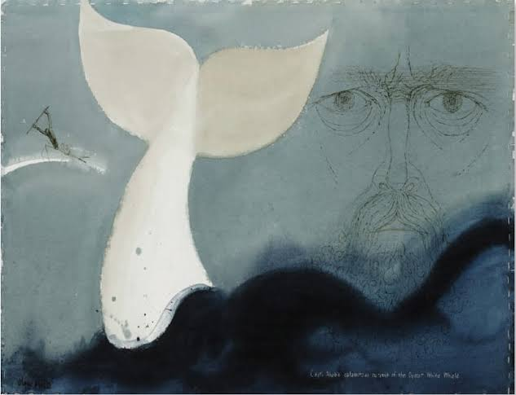
Claus Hoie
Great Whale, 1995

Slide 14
Connections
All 3 Artists:
Emphasized scale.
The ocean is HUGE!
We are tiny.
Our impact on the ocean is HUGE!

Slide 15
Takeaways
I want our mural to emphasize the vastness of the ocean. It’s power. Its connectivity. Its history: good, bad, past, future. It has always been and will always be there.
Shipping containers are visually incredible and create a pixelated look that could be good in mural form. A nice pop of color and/or selfie moment.

Slide 16
Takeaways
I want our mural to emphasize the vastness of the ocean. It’s power. Its connectivity. Its history: good, bad, past, future. It has always been and will always be there.
Shipping containers are visually incredible and create a pixelated look that could be good in mural form. A nice pop of color and/or selfie moment.

Slide 18
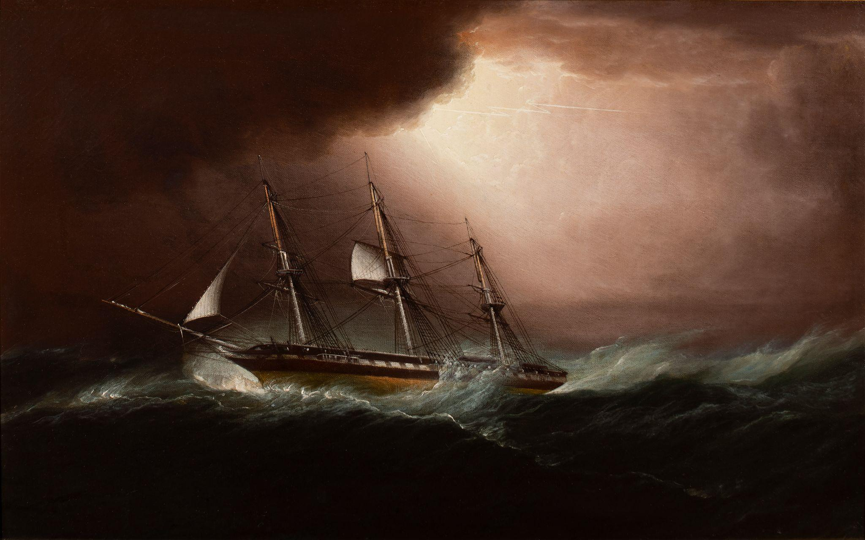
James Edward Buttersworth
(American, b. United Kingdom, 1817-1894)
American Frigate in a Hurricane, ca. 1855
Oil on canvas
Gift of Carolyn K. and Richard F. Barry III. 2017.7
Photo by Patrick Cagney

Slide 19
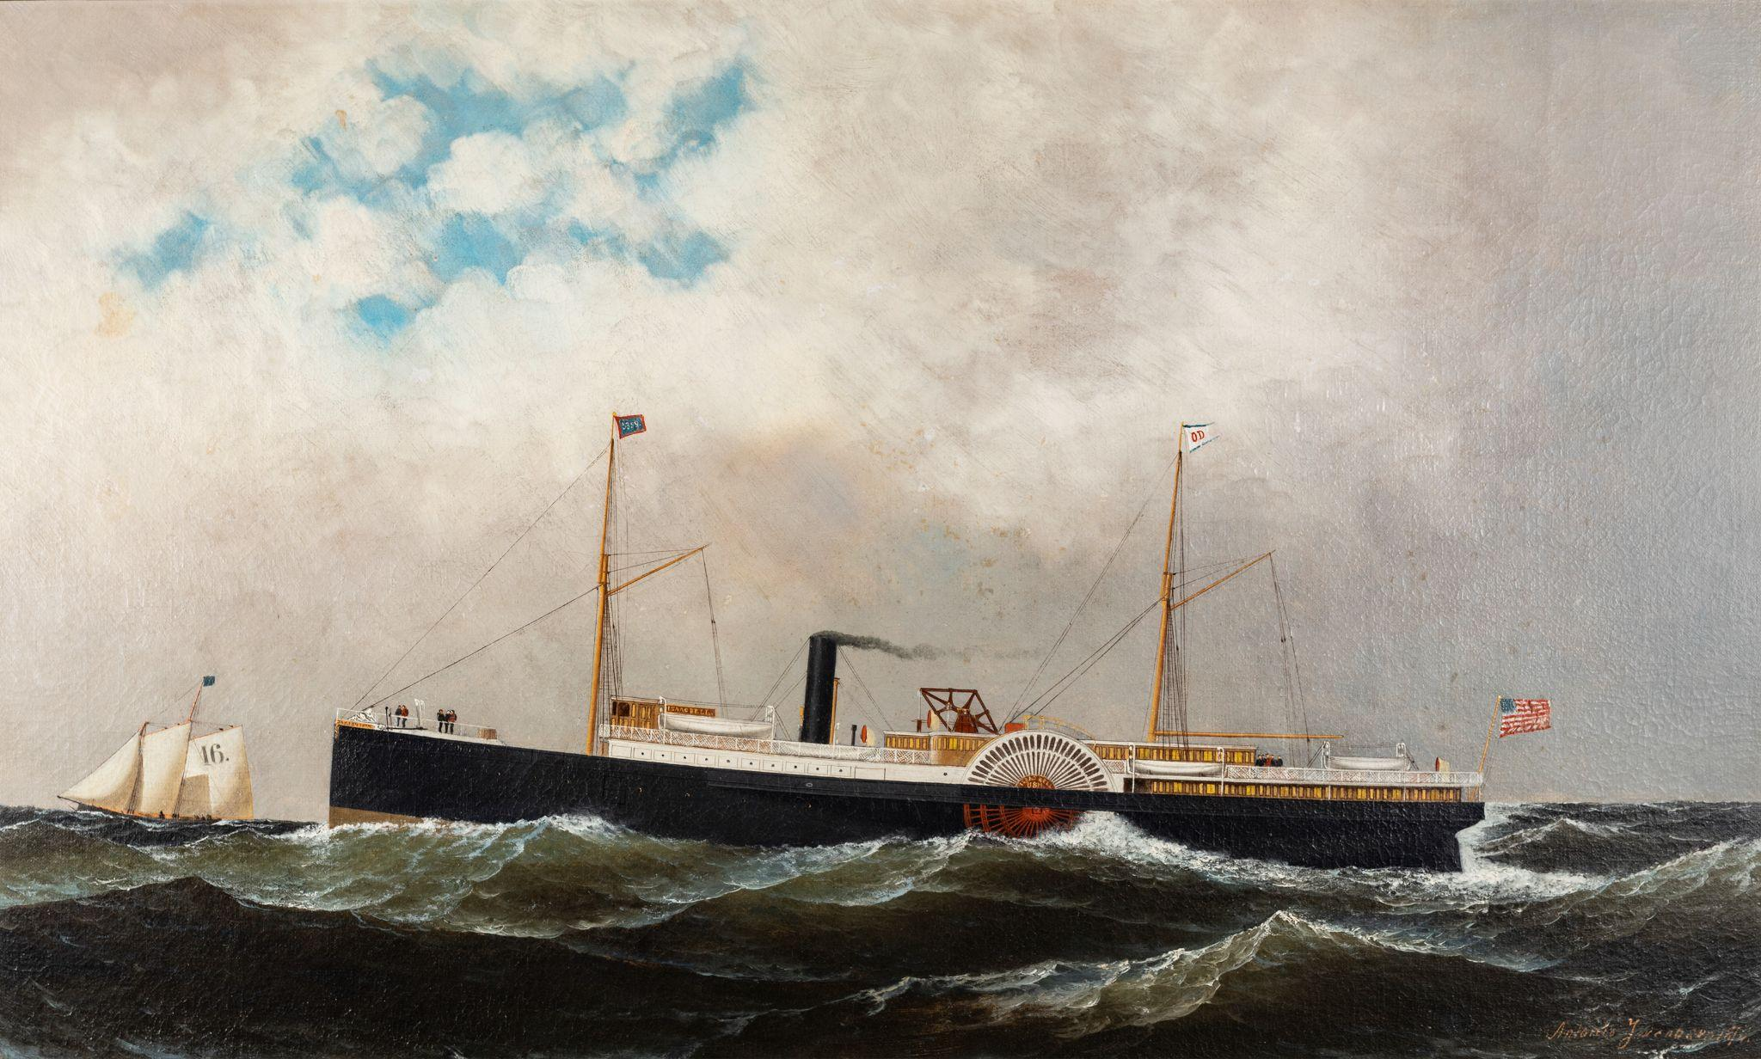
Antonio Jacobsen
(American, b. Denmark, 1850-1921)
Old Dominion Line Stamer Isaac Bell off Sandy Hook with Pilot Schooner No. 16, Christian Bergh, in the Distance, 1876
Oil on canvas
Gift of Carolyn K. and Richard F. Barry. 2017.19
Photo by Patrick Cagney

Slide 20
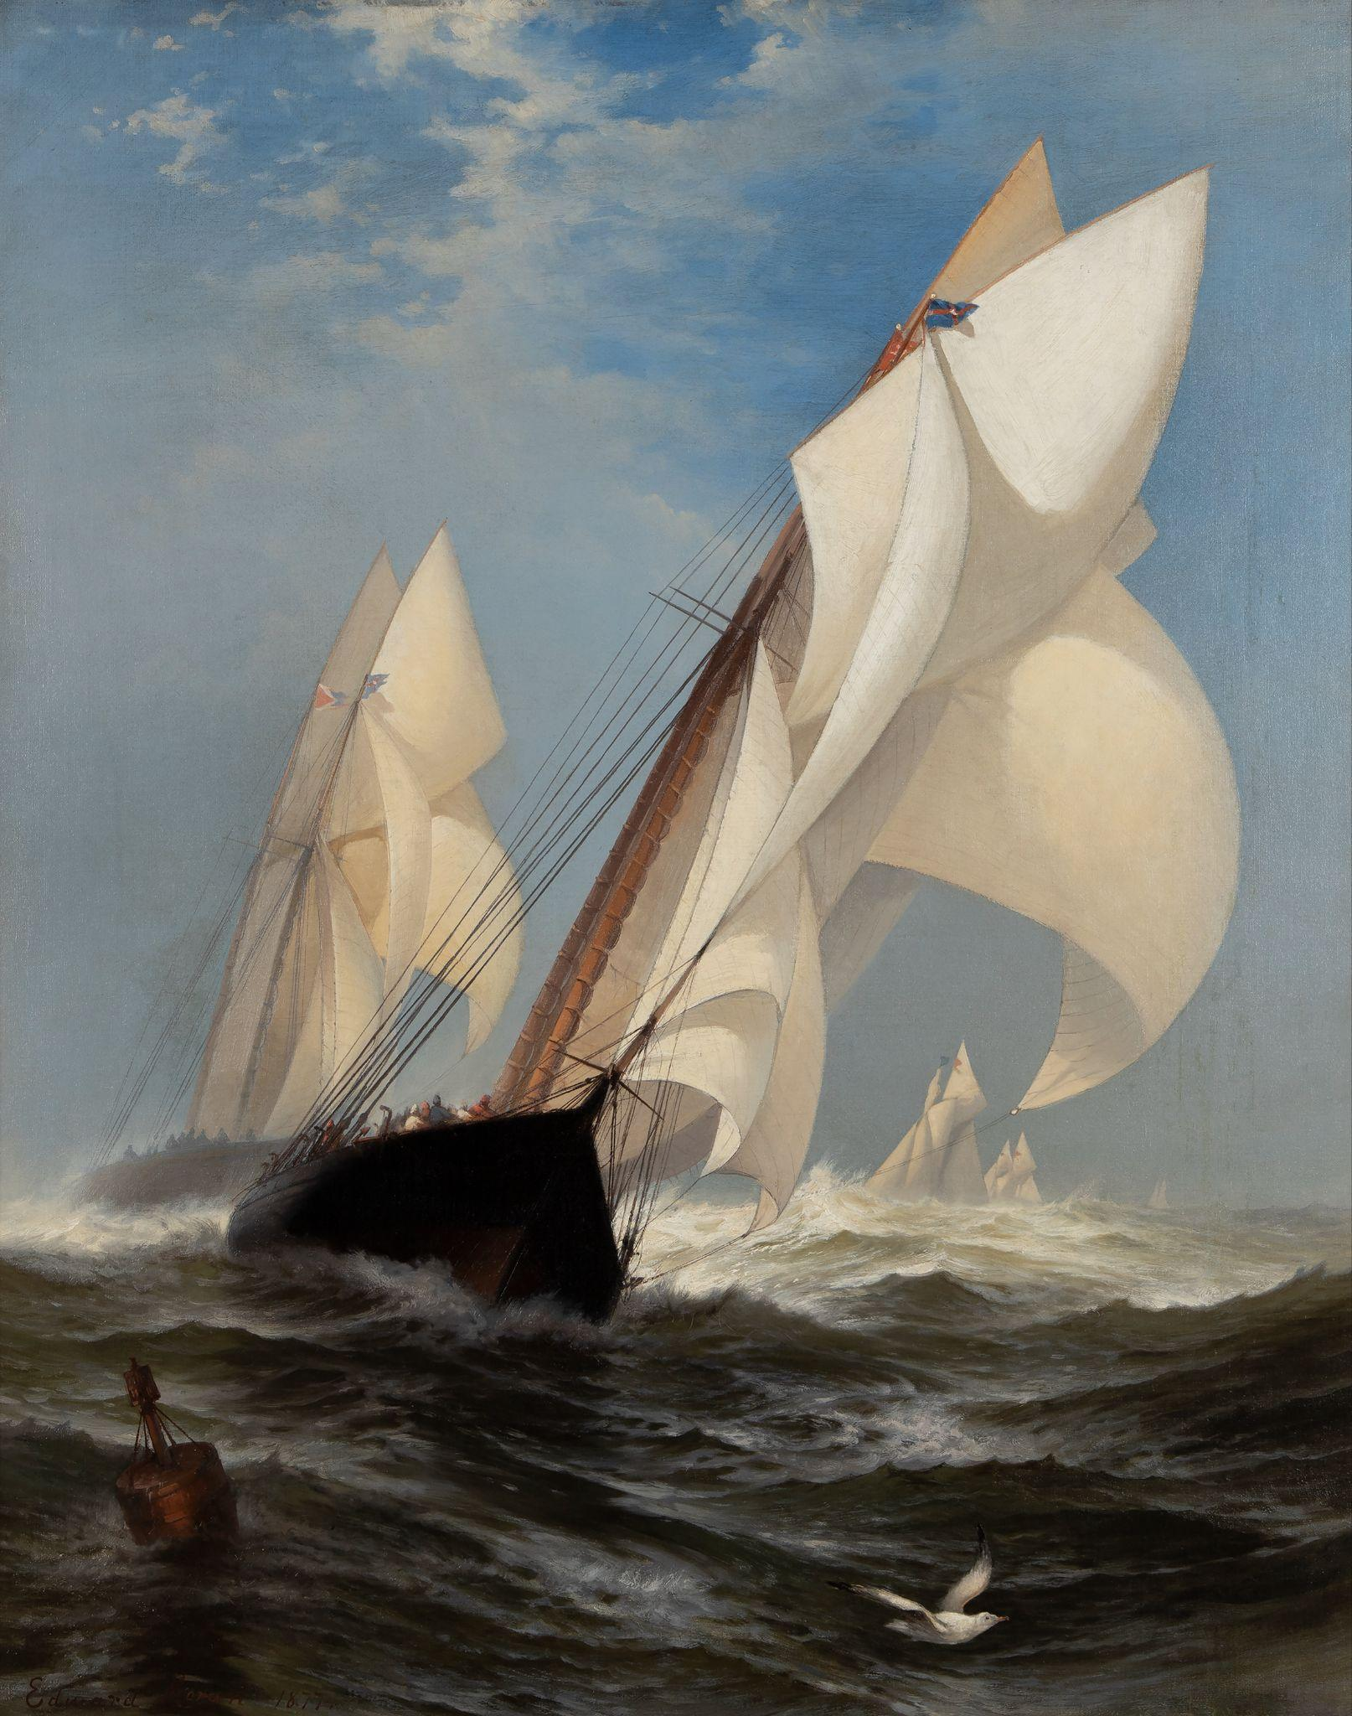
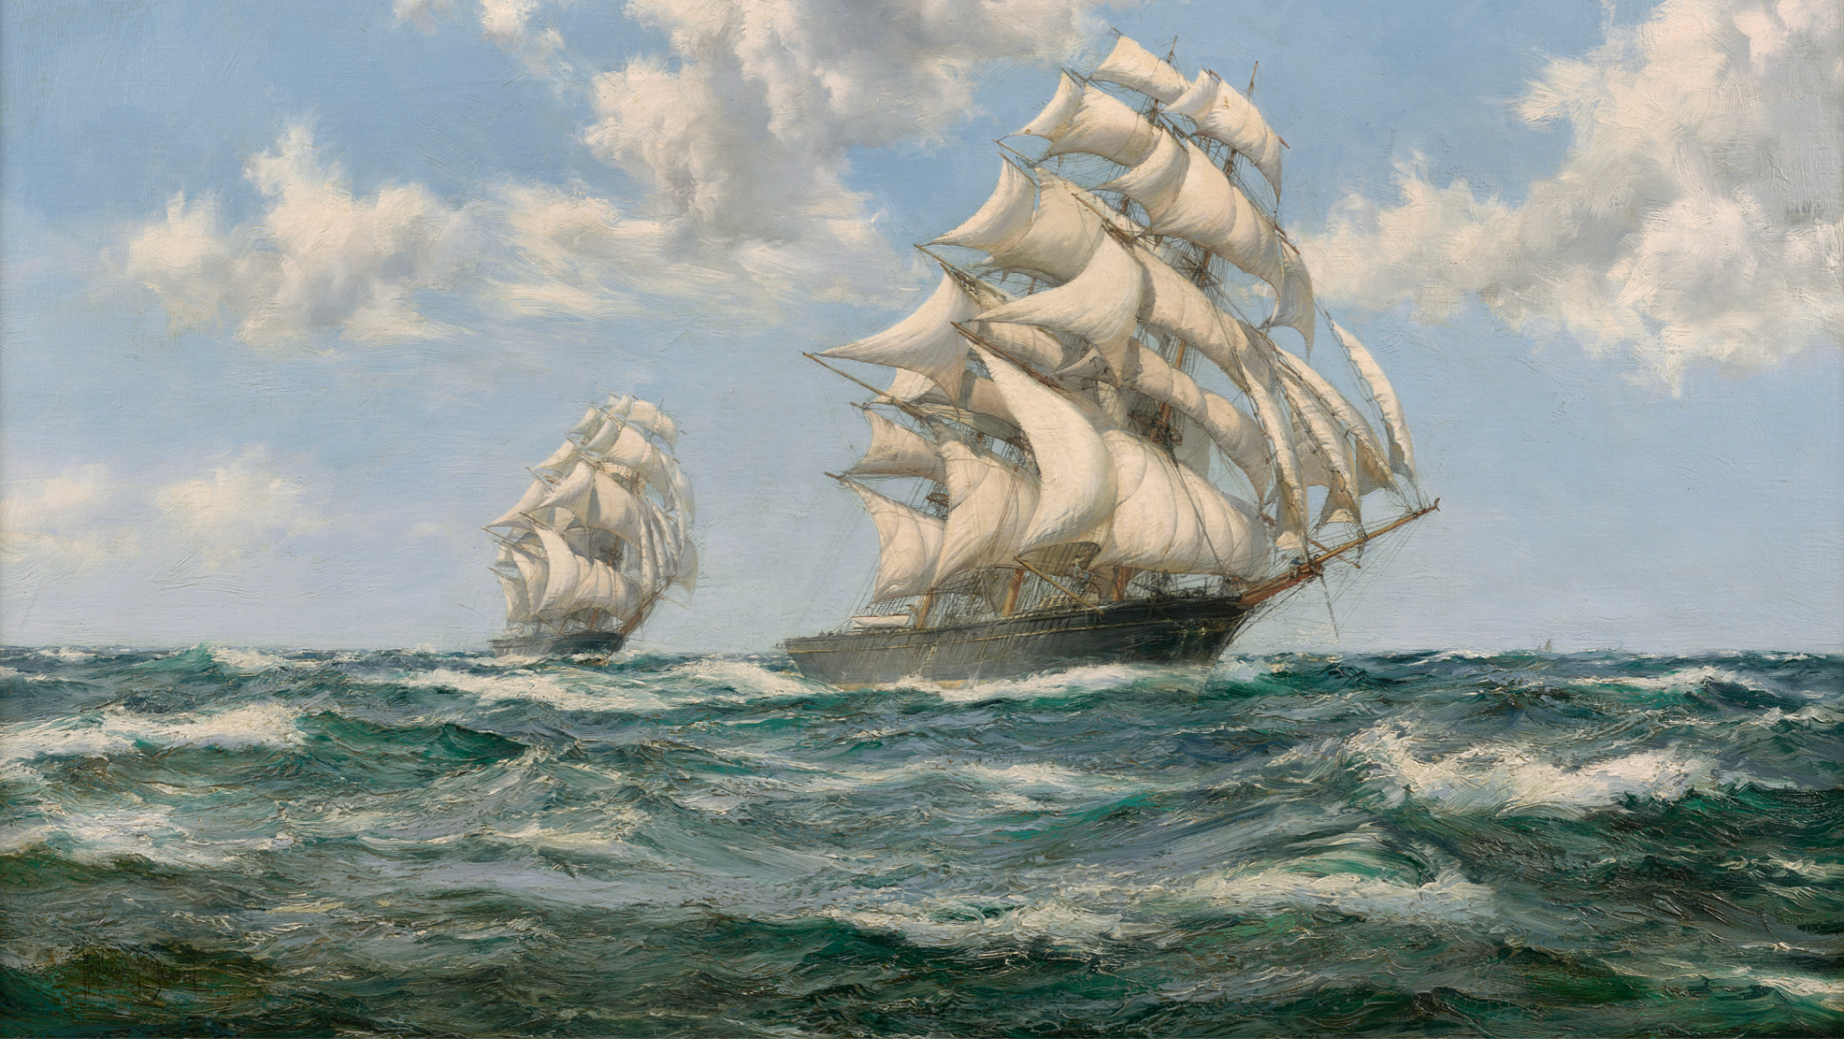
Montague Dawson (British, 1895-1973)
The Tea Clipper Race of 1866 Between the “Ariel” and “Taeping,”
Oil on canvas
On loan from Carolyn K. and Richard F. Barry III
Edward Moran
(American, b. United Kingdom, 1829-1901)
The Winning Yacht: "Countess of Dufferin" and "Madeline," 1877
Oil on Canvas
Carolyn K. And Richard F. Barry III Art Purchase Fund. 2018.17
Photo by Patrick Cagney

Slide 21
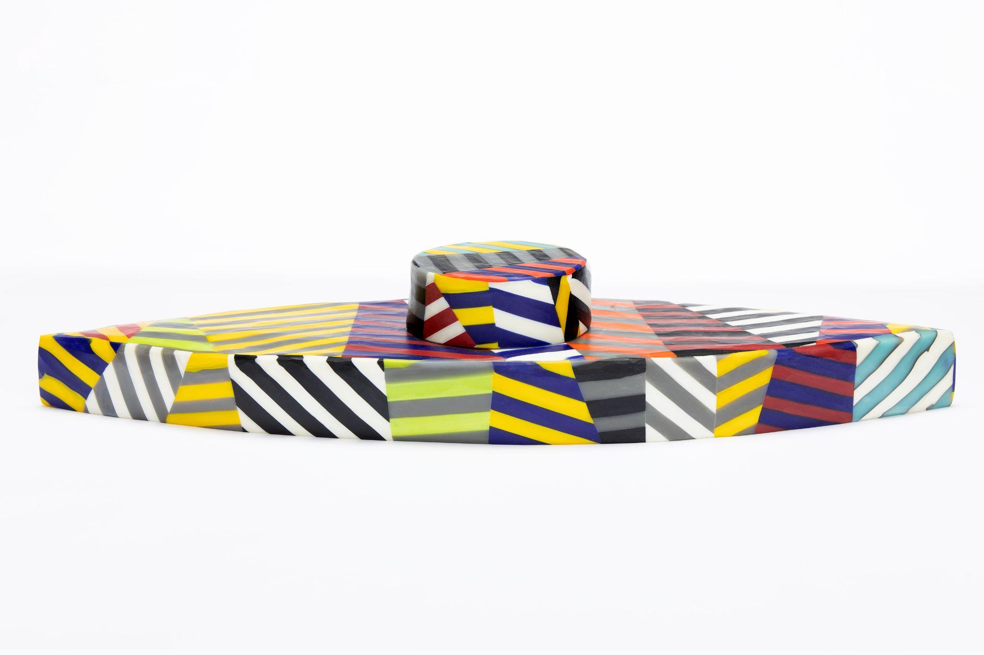
Richard Marquis
(American, b. 1945)
Monitor 12-6, 2012
Hot slab glass
Gift of Carolyn K. and Richard F. Barry III. 2017.90
Photo by Patrick Cagney

Slide 22
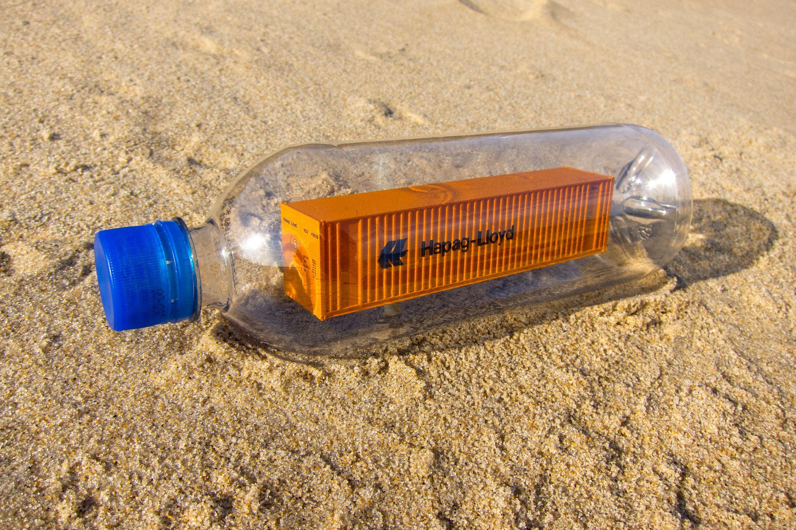
Peter Eudenbach
(American, b. 1965)
Flotsam/Jetsom, 2007/2015
Digital print
On loan from the artist

Slide 23
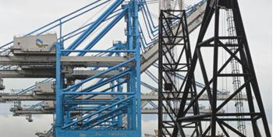
Janos Enyedi
(American, 1947-2011)
The Port of Virginia, 2005
Pigmented inkjet print
On loan from the Chrysler Museum of Art. Gift of Walter P. Chrysler, Jr. by exchange in Honor of David Goode.
© Janos Enyedi

Slide 24
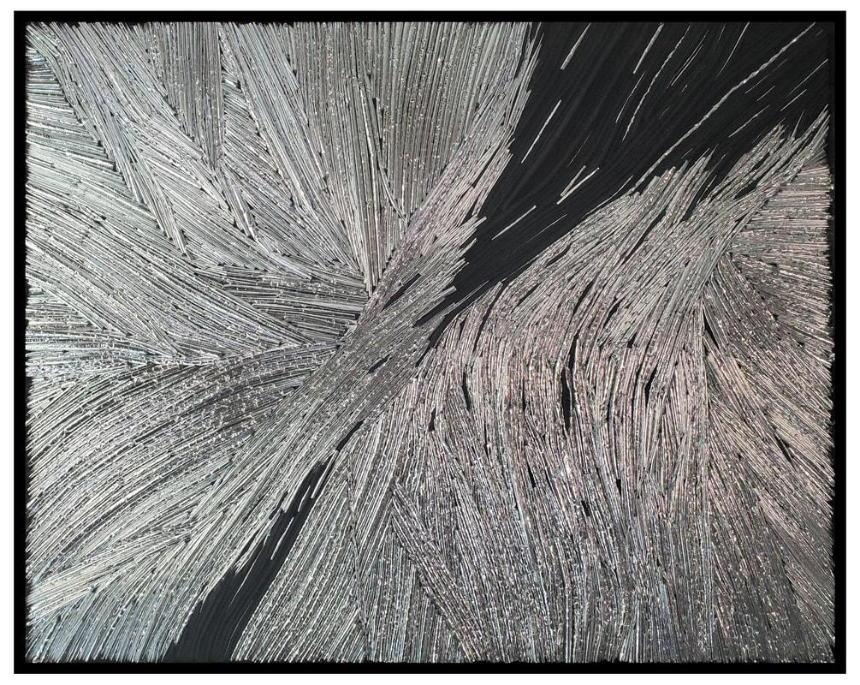
Melissa Hill (American, b. 198X)
Untitled, 2013
Thermal Bag, Adhesive, Felt,
On Loan from the Artist

Slide 25
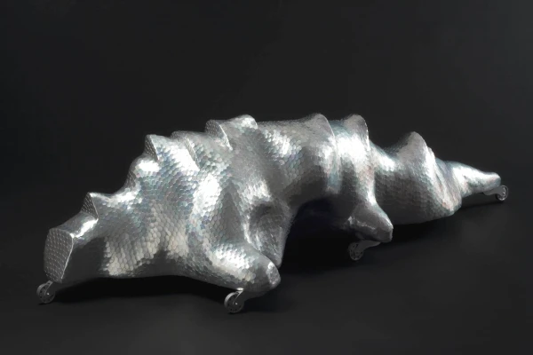
John R. G. Roth
Cretaceous Mode, 2010
On Loan from the Artist

Slide 26
Questions? Thoughts?
Bibliography

